Slide 1
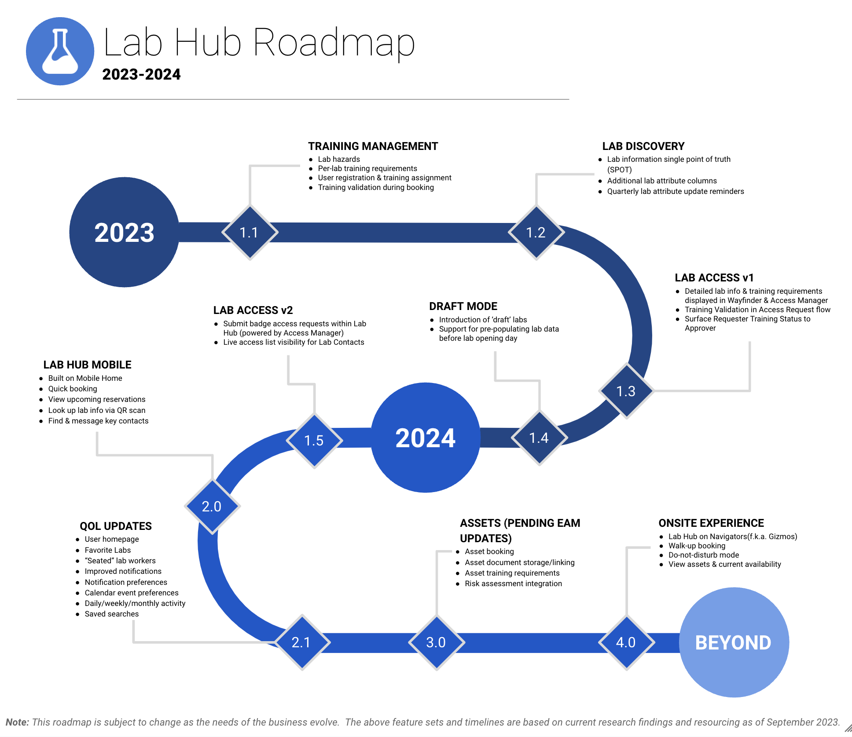
Lab Hub
The Business Need
Reality Labs needed a unified Lab Management Tool. Their previous solution siloed systems and overlapping/redundant data sets creating multiple points of “truth.”
What We Did
Affirma built a scalable lab management tool on Meta’s internal platform. Lab Hub is a single point of truth for lab booking, lab usage, and training validation.
Managed Service Team
Full Time Project Manager, Data Analyst, Change Management Manager, 4 Engineers
Services & Technology
Cornerstone, Archibus, Wayfinder, Hive, and Tableau Integration
REACT & ENT Development
User Experience & Usability Design
Change Management

